Slide 1


Student
Class/blueprint
attributes
behaviour
Rollno
Name
Age
Address
getName()
getAddress()
Object/instance
Rollno: 2 Name: Rita
Age: 20 Address: mumbai
Rollno: 1 Name: Anil
Age: 22 Address: pune

Slide 2
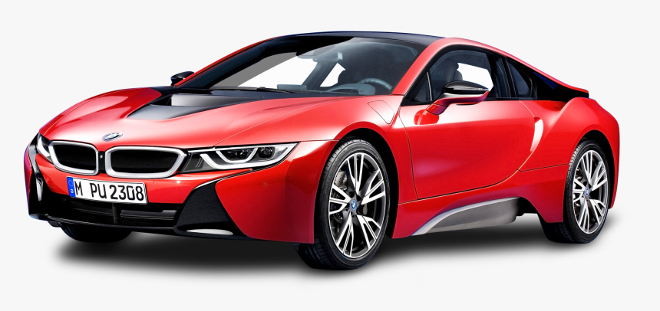
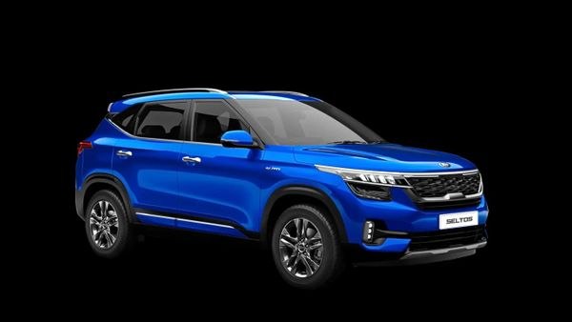
Car
Class/blueprint
attributes
behaviour
Id
Model
Price
Color
start()
stop()
applybreak()
Object/instance
Id: 1 Model: BMW HD
Price: 80 lakhs Color: red
Id: 2 Model: Kia Seltos
Price: 30 lakhs Color: blue

